Slide 1
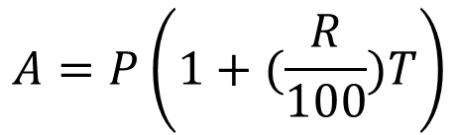
START
INPUT P, R, T
CALCULATE
$$A=P\left(1+(\frac{R}{100})T\right)$$
PRINT A
END

Slide 2
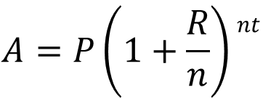
START
INPUT P, R, T, n
CALCULATE
$$A=P\left(1+\frac{R}{n}\right)nt$$
PRINT A
END

Slide 3

START
INPUT P,MT R, T, n
CALCULATE
$$A=PMT x\frac{\left[\left(1+\frac{R}{n}\right)nt −1\right]}{(\frac{R}{n})}$$
PRINT A
END

